Slide 1
Networking and Internetworking Devices

Slide 2
•
Network devices are components used to connect computers or other electronic devices together so that they can share files or resources like printers or fax machines. Devices used to setup a Local Area Network (LAN) are the most common types of network devices used by the public.
•
An internetwork is a collection of individual networks, connected by intermediate networking devices, that functions as a single large network.

Slide 3
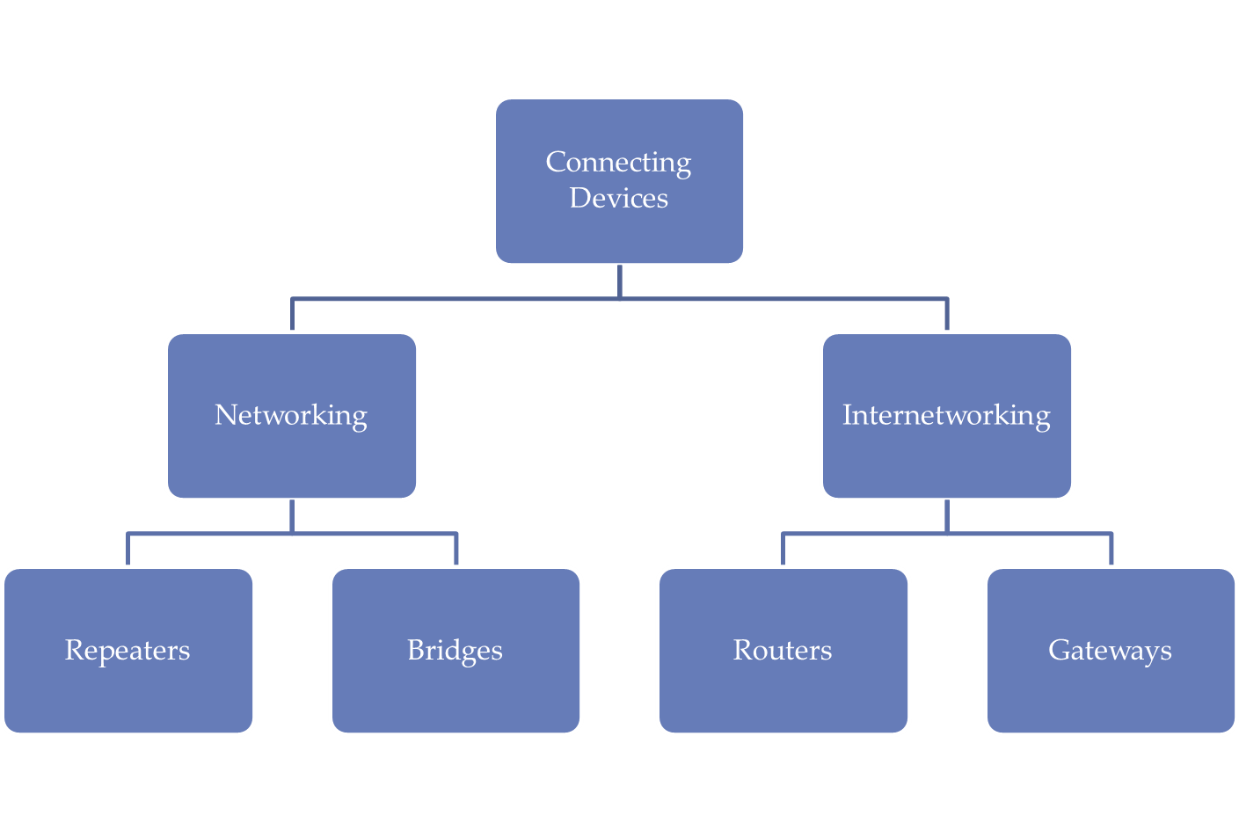

Slide 4
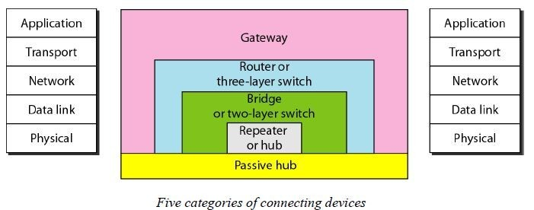
Connecting Devices
Hub

Slide 5
Hubs
A hub is basically a multiport repeater. A hub connects multiple wires coming from different branches, for example, the connector in star topology which connects different stations.
Hubs cannot filter data, so data packets are sent to all connected devices.
In other words, the collision domain of all hosts connected through Hub remains one. Also, they do not have the intelligence to find out the best path for data packets which leads to inefficiencies and wastage.

Slide 6
Types of Hubs
Active Hub:- These are the hubs that have their own power supply and can clean, boost, and relay the signal along with the network. It serves both as a repeater as well as a wiring center. These are used to extend the maximum distance between nodes.
Passive Hub :- These are the hubs that collect wiring from nodes and power supply from the active hub. These hubs relay signals onto the network without cleaning and boosting them and can’t be used to extend the distance between nodes.
Intelligent Hub :- It works like active hubs and includes remote management capabilities. They also provide flexible data rates to network devices. It also enables an administrator to monitor the traffic passing through the hub and to configure each port in the hub.

Slide 7
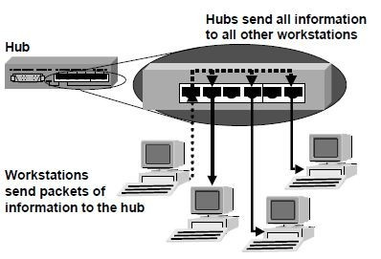
Hubs Connect Workstations Together

Slide 8
•
The receptacles on the front of the hub are called ports. There are usually from 4 to 32 ports on a hub, depending on the size of the network.
Some hubs have an additional interface port that connects to another hub, thus increasing the size of the network.
Hubs operate at the physical layer of the OSI model.
Hubs propagate signals through the network
They cannot filter network traffic
They cannot determine best path
•

Slide 9
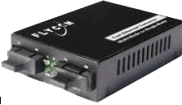
Repeater
A repeater is a device that operates only at the PHYSICAL layer.
A repeater can be used to increase the length of the network by eliminating the effect of attenuation on the signal.
It connects two segments of the same network , overcoming the distance limitations of the transmission media.
A repeater forwards every frame; it has no filtering capability
A repeater is a generator , not an amplifier.
Repeaters can connect segments that have the same access method.(CSMA/CD , Token Passing, Polling , etc.)
•

Slide 10
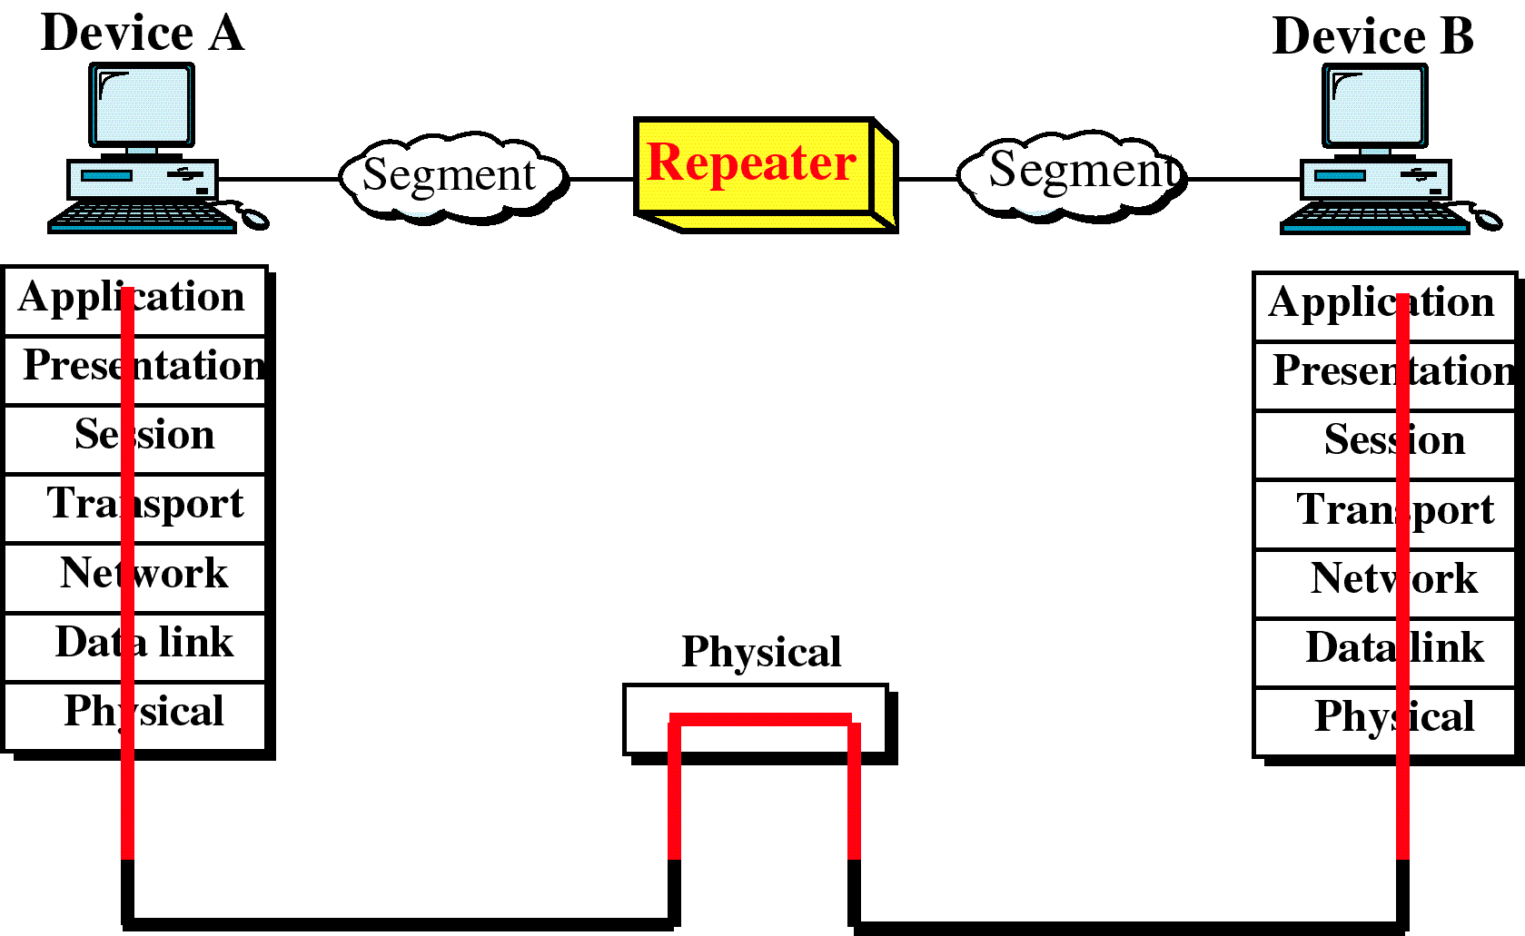
Repeater and OSI model

Slide 11
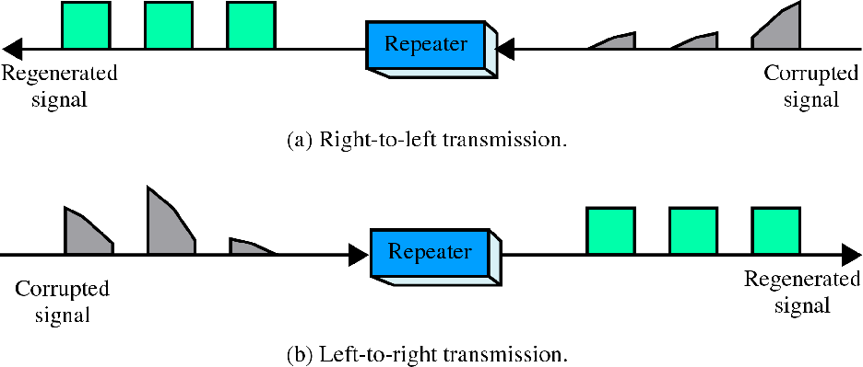
Function of repeater
Repeater is not exactly as same as Amplifier

Slide 12
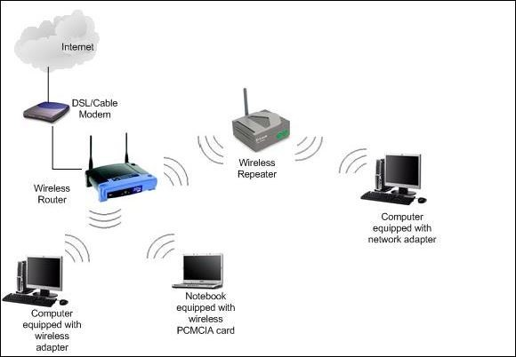
An example of use of Repeater

Slide 13
Bridge
Operates in both the PHYSICAL and the data link layer.
As a PHYSICAL layer device , it regenerates the signal it receives.
As a data link layer device , the bridge can check the PHYSICAL / MAC addresses (source and destination) contained in the frame.
A bridge has a table used in filtering decisions.
It can check the destination address of a frame and decide if the frame should be forwarded or dropped.
If the frame is to be forwarded, the decision must specify the port.
A bridge has a table that maps address to ports.
Limit or filter traffic keeping local traffic local yet allow connectivity to other parts (segments).
•
•

Slide 14
Types of Bridges
Transparent Bridges:- These are the bridge in which the stations are completely unaware of the bridge’s existence i.e. whether or not a bridge is added or deleted from the network, reconfiguration of the stations is unnecessary. These bridges make use of two processes i.e. bridge forwarding and bridge learning.
Source Routing Bridges:- In these bridges, routing operation is performed by the source station and the frame specifies which route to follow. The host can discover the frame by sending a special frame called the discovery frame, which spreads through the entire network using all possible paths to the destination.

Slide 15
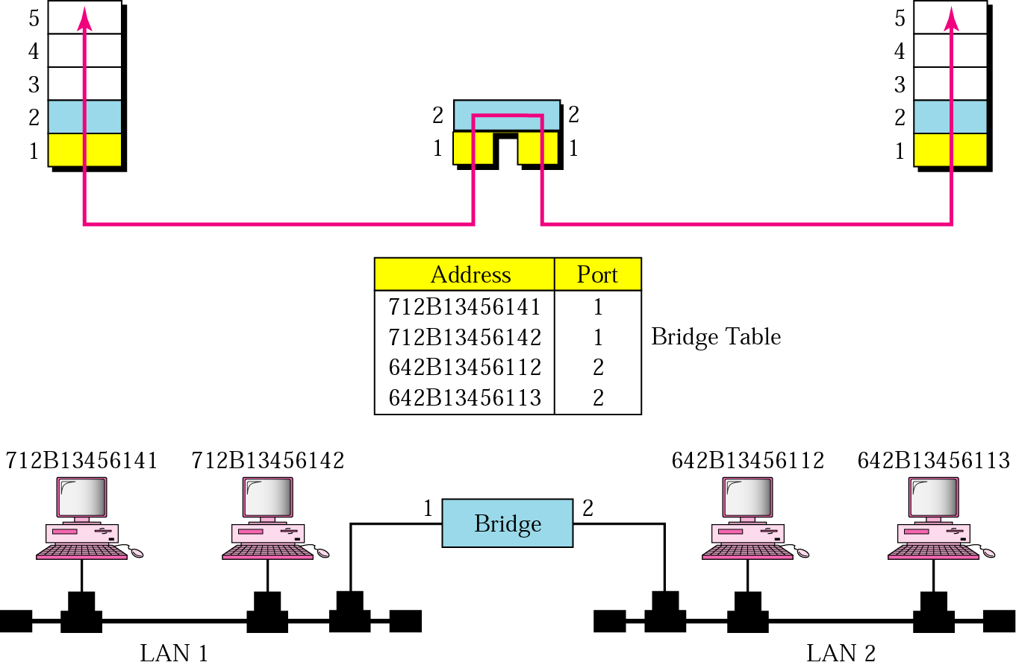
Bridge

Slide 16
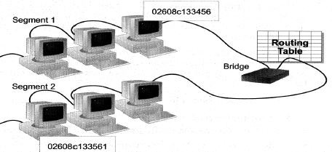
How Bridges Work
•
Bridges work at the Media Access Control Sub-layer of the OSI model
Routing table is built to record the segment no. of address
If destination address is in the same segment as the source address, stop transmit
Otherwise, forward to the other segment
•
•
•

Slide 17
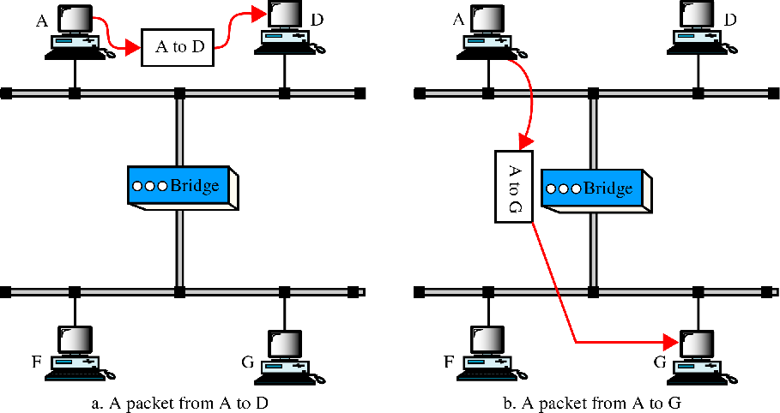
Function of a bridge

Slide 18
Characteristics of Bridges
Contains one entry per station of network to which bridge is connected.
Is used to determine the network of destination station of a received packet.
Filtering
Is used by bridge to allow only those packets destined to the remote network.
Packets are filtered with respect to their destination and multicast addresses.
Forwarding
The process of passing a packet from one network to another.
Learning Algorithm
The process by which the bridge learns how to reach stations on the internetwork.

Slide 19
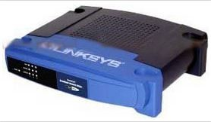
Advantages And Disadvantages Of Bridges
Advantages of using a bridge
Extend physical network
Reduce network traffic with minor segmentation
Creates separate collision domains
Reduce collisions
Connect different architecture
Disadvantages of using bridges
Slower than repeaters due to filtering
Do not filter broadcasts
More expensive than repeaters

Slide 20
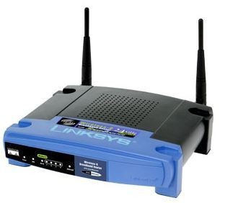
Routers
•
Routes packets based on their logical addresses (host-to-host addressing).
A router normally connects LANs and WANs in the Internet and has a routing table that is used for making decision about the route.
The routing tables are normally dynamic and are updated using routing protocols.
Routers can increase network efficiency by filtering out broadcast traffic between networks, thus reducing unnecessary traffic between networks.
•
•
•

Slide 21
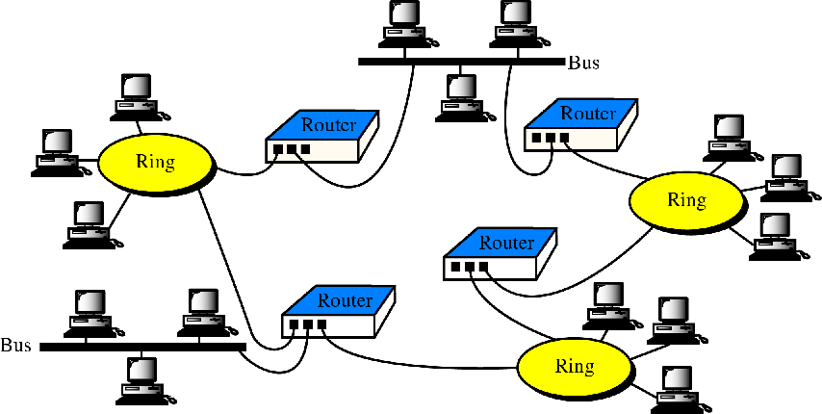
Routers in an internet

Slide 22
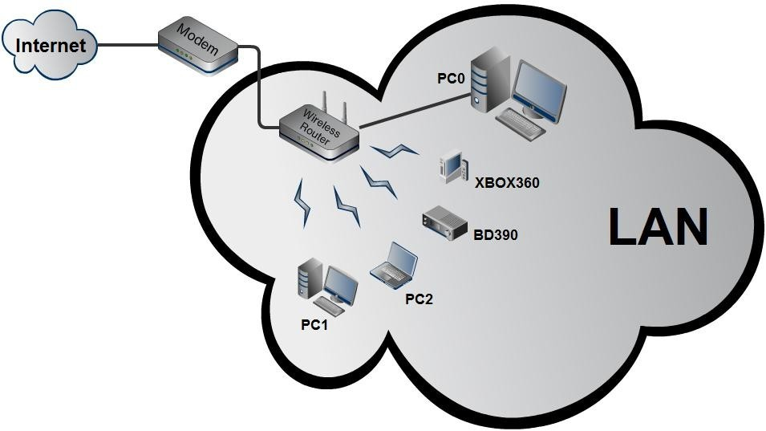
Operation of Router

Slide 23
Routing Tables
Routers contain internal tables of information called routing tables that keep track of all known network addresses and possible paths throughout the internetwork, along with cost of reaching each network. Routers route packets based on the available paths and their costs, thus taking advantage of redundant paths that can exist in a mesh topology network.
•
•
Because routers use destination network addresses of packets, they work only if the configured network protocol is a routable protocol such as TCP/IP or IPX/SPX. This is different from bridges, which are protocol independent. The routing tables are the heart of a router; without them, there's no way for the router to know where to send the packets it receives.

Slide 24
Terms Associated with Routers
Static routers: These must have their routing tables configured manually with all network addresses and paths in the internetwork.
Dynamic routers: These automatically create their routing tables by listening to network traffic.
Routing tables are the means by which a router selects the fastest or nearest path to the next "hop" on the way to a data packet's final destination. This process is done through the use of routing metrics.
Routing metrics which are the means of determining how much distance or time a packet will require to reach the final destination. Routing metrics are provided in different forms.
Hop is simply a router that the packet must travel through.
Ticks measure the time it takes to traverse a link. Each tick is 1/18 of a second. When the router selects a route based on tick and hop metrics, it chooses the one with the lowest number of ticks first.
•
•
•
•
•
•

Slide 25
Routers versus Bridges
Addressing
Routers are explicitly addressed.
Bridges are not addressed. Availability
Routers can handle failures in links, stations, and other routers.
Bridges use only source and destination MAC address, which does not guarantee delivery of frames.
Message Size
Routers can perform fragmentation on packets and thus handle different packet sizes.
Bridges cannot do fragmentation and should not forward a frame which is too big for the next LAN.
Forwarding
Routers forward a message to a specific destination.
Bridges forward a message to an outgoing network.

Slide 26
Gateways
•
Gateways are multi-purpose connection devices. They are able to convert the format of data in one computing environment to a format that is usable in another computer environment (for example, AppleTalk and DECnet).
The term gateway is sometimes used when referring to a router. For the purpose of this lesson, gateways are devices that link different network types and protocols. For example, gateways translate different electronic mail protocols and convey email across the Internet
•

Slide 27
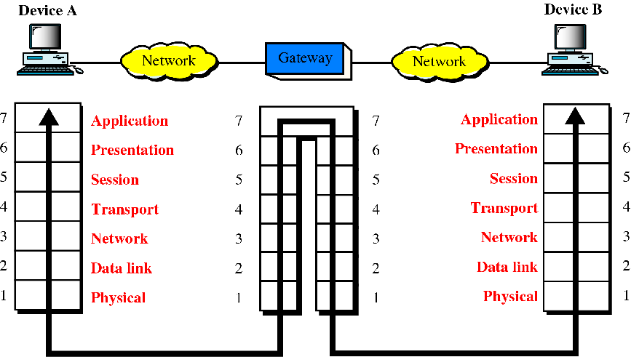
Gateways (protocol converter)

Slide 28
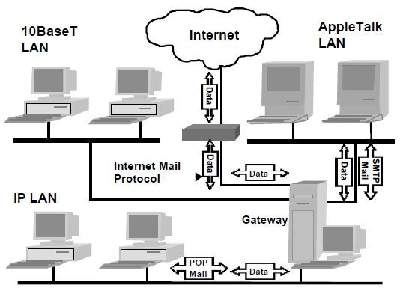
Gateways Translate Different Network Protocols

Slide 29
Examples
E-mail gateways-for example, a gateway that receives Simple Mail Transfer Protocol (SMTP) e-mail, translates it into a standard
X.400 format, and forwards it to its destination
Gateway Service for NetWare (GSNW), which enables a machine running Microsoft Windows NT Server or Windows Server to be a gateway for Windows clients so that they can access file and print resources on a NetWare server
Gateways between a Systems Network Architecture (SNA) host and computers on a TCP/IP network, such as the one provided by Microsoft SNA Server
A packet assembler/disassembler (PAD) that provides connectivity between a local area network (LAN) and an X.25 packet-switching network

Slide 30
Gateways can operate at all layers of the OSI model since they:
Can provide a physical link between networks.
Create junctions between dissimilar networks.
Translate different network protocols and/ or applications (for example, electronic mail between the Internet and a commercial online service with its own mail protocol).

Slide 31
Switches
•
Switches are a special type of hub that offers an additional layer of intelligence to basic, physical- layer repeater hubs. A switch must be able to read the MAC address of each frame it receives. This information allows switches to repeat incoming data frames only to the computer or computers to which a frame is addressed. This speeds up the network and reduces congestion.
As with hubs, Ethernet implementations of network switches are the most common. Mainstream Ethernet switches support either 10/100 Mbps Fast Ethernet or Gigabit Ethernet (10/100/1000) standards.
•

Slide 32
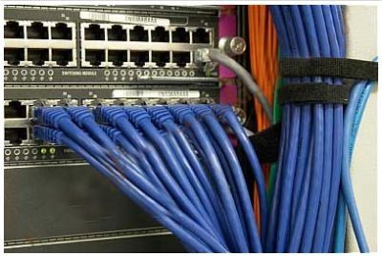

Switches operate at both the physical layer and the data link layer of the OSI Model.

Slide 33
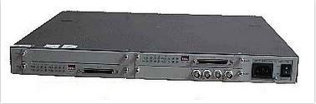
Brouters
•
Brouters are a combination of router and bridge. This is a special type of equipment used for networks that can be either bridged or routed, based on the protocols being forwarded. Brouters are complex, fairly expensive pieces of equipment and as such are rarely used.
•
A Brouter transmits two types of traffic at the exact same time: bridged traffic and routed traffic. For bridged traffic, the Brouter handles the traffic the same way a bridge or switch would, forwarding data based on the physical address of the packet. This makes the bridged traffic fairly fast, but slower than if it were sent directly through a bridge because the Brouter has to determine whether the data packet should be bridged or routed.

Slide 34
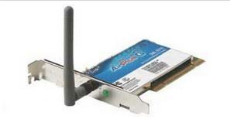
NIC(Network Interface Card)
•
Network Interface Card, or NIC is a hardware card installed in a computer so it can communicate on a network. The network adapter provides one or more ports for the network cable to connect to, and it transmits and receives data onto the network cable.
Wireless Lan card
•

Slide 35
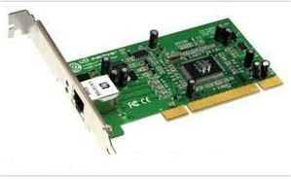
•
Every networked computer must also have a network adapter driver, which controls the network adapter. Each network adapter driver is configured to run with a certain type of network adapter.
Network Interface Adapter Functions:
Data encapsulation
Signal encoding and decoding
transmission and reception
Data buffering Serial/parallel conversion Media access control

